Slide 1
SPECIALISED PROCEDURES (I)
LUYALI ETALE

Slide 2
DIAGNOSTIC PROCEDURES
Lumbar puncture
Biopsies
Paracentesis (thoracis & abdominis)
Urinary bladder irrigation
Cholecystogram
Cholangiogram
Venogram
Myelogram
Hysterosalpingogram- Assignment
Retrograde pyelogram
Endoscopic retrograde cholangio-pancretography (ERCP)
Stoma care

Slide 3
RADIOLOGICAL EXAMINATIONS
Common x-rays: Chest , Skull, Bones
Computer tomography (CT) scan
Magnetic resonance imaging (MRI)
Endoscopies: Oesophagoscopy Gastroscopy, Sigmoidoscopy, Protoscopy, Bronchoscopy, Cystoscopy, Laparascopy
EEG (electroencephalography)
ECG(electrocardiogram)
Ultrasound

Slide 4
OTHERS:
Urinary catheterization(Male & Female)

Slide 5
Specific objectives:
By the end of the course the student will be able to:
Describe the various aseptic nursing procedures
Describe the nursing management before, during and after the procedure
Demonstrate ideal nursing skills involved in the care of the patient during and after the procedures

Slide 6
Nursing responsibilities:
1. Preparing equipment
Gathering and preparing equipment is often done by nurses.
Checking the equipment to ensure it is working properly and is ready for use on patients.
Cleaning equipment before and after each use to prevent the spread of infection.

Slide 7
Nursing responsibilities cont…
2. Preparing patients
Drawing blood or administering medication prior to testing.
Collecting specimens, such as sputum or urine samples, and sending them to the lab.
Patients may need to have an area sterilized or shaved for a surgical procedure or the application of electrodes.
Mentally preparing patients for testing by answering questions, explaining the procedure or test and possible outcomes.(refer to hospital policies).

Slide 8
Nursing responsibilities cont..
3. Assist with testing
Assisting both patients and other health care providers during diagnostic testing.
They provide patient care during the test which may include administering medicines when needed.
Position patients properly, like rolling the patient over, in order to complete the necessary diagnostic testing.
Transporting patients to and from the test can be part of their job.

Slide 9
Nursing responsibilities cont..
4. Monitor patients during testing
This includes monitoring their current medical condition, especially in those patients deemed unstable.
They must check a patient's vital signs (blood pressure, pulse, breathing rate),
Assess physical condition and keep an eye on any monitors that the patient needs to remain hooked up to during the tests, such as a heart monitor or ventilator.
Nurses may also be required to connect or disconnect any monitors or devices that can interfere with the testing.

Slide 10
Nursing responsibilities cont..
5. Reporting results
Test results are reported to the patient's doctor, specialists and others in need of the information by nurses. Results may be phoned in, faxed or sent electronically via a computer.
It may be the nurse's responsibility to check for the results of the tests as well.
They may be in charge of entering the results into the patient's medical record.
Nurses must also notify the patient's physician when abnormal or critical results that require an immediate response, such as abnormal blood work with critical potassium levels, are found.

Slide 11
Liver biopsy

Slide 12
Liver biopsy
Is a procedure where small pieces of liver tissue are removed in order to be sent to lab for examination
It’s helpful in the diagnosis of diseases that affect the liver E.g. liver cirrhosis
Purpose
Diagnosis: this allows establishment of very specific diagnosis
Monitoring: monitoring effectiveness of therapy that the patient is receiving for a liver disease. It can also provide warning if certain therapies the patients are receiving are damaging to the liver

Slide 13
Indications
Alcoholic liver
Elevated liver enzymes of unknown origin
Jaundice and billiary tract obstruction
Hemochromatosis
Hepatomegally of undetermined cause
Autoimmune liver disease
Cancers of the liver and non cancerous tumor
Chronic viral hepatitis
Liver transplantation- to rule out rejection

Slide 14
Procedure
Requirements on trolley:
As for bone marrow biopsy with addition of the following
Scalpel or blade
Specimen jar
Menghini liver biopsy needle
Preparation
Ascertain the results of coagulation tests- prothrombin time, partial thromboplastin time, and platelet count
Check for signed consent- confirm that informed consent has been provided

Slide 15
Preparation cont…
c) Take and record patient’s vital signs immediately before biopsy
d)Explain the procedure to the patient- steps of the procedure, sensations expected, after-effects expected, restrictions of activity and monitoring procedures to follow
Steps
Support the patient during the procedure
Expose the right side of the patients upper abdomen(right hypochondriac)
Instruct the patient to inhale and exhale deeply several times finally to exhale and to hold breath at the end of expiration(prevents puncturing of the diaphragm and risk of lacerating the liver is minimized)
The physician promptly introduces the biopsy needle by way of the trans thoracic (inter costal) or trans abdominal (sub costal) route, penetrates the liver, aspirates and withdraws. The entire procedure is completed within 5-10 seconds.
Instruct the patient to resume breathing

Slide 16
Nursing care post procedure
1)Immediately after biopsy, assist the patient to turn onto the right side; place a pillow under costal margin, and caution the patient to remain in this position, recumbent and immobile, for several hours.
Instruct the patient to avoid coughing or straining.
In this position, the liver capsule at the site of penetration is compressed against the chest wall, and the escape of blood or bile through the perforation is prevented.
2) Measure and record patients pulse, respiratory rate and BP at 10-15 minutes intervals for the first hour , then 30 minutes for the next 2hrs, or until the patient stabilizes.

Slide 17
Changes in vital signs may indicate; bleeding, severe haemorrhage or bile peritonitis, most frequent complications of liver biopsy.
3)If the patient is discharged after the procedure, instruct the patient to avoid heavy lifting and strenuous activity for one week.
Complication
Fever
Pain, swelling, redness or discharge around needle insertion site
Chest pains
Shortness of breathing
Fainting or dizziness- sign of possible blood loss
Nausea and vomiting
Worsening abdominal pains – bleeding, leakage of bile

Slide 18


Slide 19
Renal biopsy

Slide 20
Renal biopsy(needle biopsy of the kidney)
This is removal of a small piece of kidney tissue for examination.
It can be done through;
Ultra sound guided kidney biopsy
CT-guided kidney biopsy
Or surgical biopsy

Slide 21
Indications
Contraindications
Protein in urine
Unexplained acute renal failure
Glomerulopathies
Transplant rejection
Bleeding tendencies
Uncontrolled hypertension
Solitary kidney
Morbid obesity

Slide 22
Nursing role before procedure
Patient preparation
Coagulation tests to identify patients at risk of post biopsy bleeding
Starve the patient for 6-8hrs(incase of nephrectomy)
Vital signs: BP, Spo2, PR, RR
Establish an intravenous line
Urine specimen is taken before biopsy for baseline data
Explain the procedure to the patient
Place the patient in prone position and place a sandbag under the abdomen
Fold down the bed clothes and expose the lumbar region
Sedation, if ordered is given
Instruct the patient to hold his breath(to stop movement of the kidney) during the insertion of biopsy needle. If sedated place in prone with a sandbag under the abdomen

Slide 23
Procedure
Requirements
Top shelf: sterile renal biopsy set containing;
Towel and gloves
Towel with a hole for draping
Gauze and cotton wool swabs
Sponge holding forceps
Dissecting forceps
Small curved scissors trocar and cannula
Renal biopsy needle
Glass slides
Specimen jar gallipots
receiver

Slide 24
Requirements cont…
20mls and 5mls syringes and needles
Scapel
Bottom shelf:
2% lignocaine
Antiseptic lotions; methylated spirit, savlon, and iodine
Assorted sizes of syringes and needles
Receiver
Mackintosh and towel
Shoulder blanket
Sandbag
Strapping
Shaving tray
collodion

Slide 25
Steps
Explain the procedure to the patient
Place the patient in prone position and place a sandbag under the abdomen
Fold down the bed clothes and expose the lumbar region
Cover patient with shoulder blanket
Protect the bed clothes with mackintosh and towel
Wash hands
Assist as required
Skin is cleaned with antiseptic

Slide 26
Procedure
The skin at the biopsy site is infiltrated with a local anaesthetic
The biopsy needle is introduced just inside the renal capsule of the outer quadrant of the kidney
The location of the needle may be confirmed by fluoroscopy or by ultra sound, in which case a special probe is used
With open biopsy, a small incision is made over the kidney allowing direct visualization .
Preparation of open biopsy is similar to that of any major abdominal surgery
The doctor withdraws the biopsy needle and the specimen is placed in the jar
A very firm dressing is then applied over the puncture site

Slide 27
Nursing care
Post biopsy nursing care
Ask patient to remain in prone position for 1hr and remain on bed rest for 24hrs to minimize the risk of bleeding
Vital signs are taken every 5-15 minutes for the first 1hr, and then with decreased frequency as indicated.
Note;
Kidney is a highly vascularised organ, bleeding can occur through the puncture site and collect in peri-renal space without being noticed and can lead to shock.
A clot can form in ureters causing severe pain

Slide 28
Nursing care cont…
Observe for any signs of shock
Take post biopsy urine specimen for comparison with baseline
Hb is assessed within 8hrs
Incase of excessive bleeding;
Blood transfusion is commenced
Surgical intervention to control haemorrhage and drainage or’
Nephrectomy is done
Advise patient to avoid strenuous activity and heavy lifting for two weeks to prevent trigger of delayed hemorrhage
Patient should report back incase of any signs or symptoms of bleeding(haematuria, fainting, dizzyness)

Slide 29
THORACENTESIS

Slide 30
THORACENTESIS
A surgical perforation of the chest wall and pleural space with a large bore needle.
Indications
To obtain specimens for diagnostic evaluation
Instill medication to the pleural space
Remove fluid (effusion)or air from the pleural space to relive pleural pressure

Slide 31
Specific indications
Potential diagnoses:
Transudates (heart failure, cirrhosis, nephritic syndrome)
Exudates (inflammatory, infectious, neoplastic conditions)
Empyema
Pneumonia
Blunt, crushing, or penetrating chest injuries/trauma or invasive thoracic procedures such as lung and/ or cardiac surgery.

Slide 32
Indications cont…
2. Client presentation:
Large amounts of fluid in the pleural space compress lung tissue and can cause pain, shortness of breath, cough, and other symptoms of pleural pressure.
Decreased breath sounds , dull percussion sounds, and decreased chest wall expansion.

Slide 33
Nursing care
Pre procedure
Nursing actions:
Ensure that the client has signed the informed consent.
Gather all needed supplies.
Obtain pre procedure x-ray as prescribed to locate pleural effusion and to determine needle insertion site.
Position the client sitting upright with his arms and shoulders raised and supported on pillows or on an over bed table with his feet and legs well supported.

Slide 34
Nursing care cont…
Client education.
Instruct the client to remain absolutely still during the procedure and not to cough or talk unless instructed by the primary care provider.
Intra procedure
Assist in the procedure by ensuring strict surgical aseptic technique.
Prepare the client for a feeling of pressure with the needle insertion and fluid removal.

Slide 35
Nursing care (intra)
Monitor the client’s vital signs, skin color, and oxygen saturation throughout the procedure.
Measure and record the amount of fluid removed from the client’s chest.
Label the specimens at the bedside and promptly send them to the laboratory.
NB: the amount of fluid removed is limited to 1 litre at a time to prevent cardiovascular collapse.

Slide 36
Nursing care cont…
Post procedure
Apply a dressing over the puncture site and position the client on the unaffected side for one hour.
Monitor the client’s vital signs and respiratory status hourly for the first several hours after the procedure.
Encourage the client to deep breathe to help in lung expansion.
The client can resume normal activities after one hour if no signs of complications are present.
Obtain post procedure chest x-ray (check resolutions and rule out pneumothorax)

Slide 37
Complications
Pneumothorax
Subcutaneous emphysema
Bleeding
Infection
Pulmonary oedema. (after sudden shift in mediastinal contents when large amounts of fluids are aspirated)

Slide 38
Abdominal Paracentesis

Slide 39
ABDOMINAL PARACENTESIS/ ABDOMINAL TAPPING
This is the puncture of the abdomen and the withdrawal of fluid that has collected in the peritoneal cavity.
The fluid build up is called ascites
It relieves abdominal pressure and obtains specimen for laboratory analysis.
Indications
To find the cause of ascites
To diagnose infection in peritoneal fluid
To check for certain types of cancer E.g liver cancer
To remove large amounts of fluid that causes pain or difficulty in breathing or that affects kidney or bowel(intestine) functioning.

Slide 40
contraindications
Mild hematologic abnormalities do not increase the risk of bleeding
The risk of bleeding may be increased if:
prothrombin time>21 seconds
international normalized ratio > 1.6
platelet count< 50,000 per cubic millimeter.
Absolute contraindication is acute abdomen that requires surgery

Slide 41
Relative contraindications are:
Pregnancy
Distended urinary bladder
Abdominal wall cellulitis
Distended bowel
Intra-abdominal adhesions

Slide 42
Preparation
Signed consent form
Prepare patient by providing the necessary information and instructions by offering re-assurance.
Instruct the patient to void.
Gather appropriate sterile equipment and collection of receptacles.
Place the patient in upright position on the edge of the bed or in a chair with feet supported on a stool.
If the patient is confined in bed use fowlers position.
Place sphygmomanometer cuff around patients arm

Slide 43
Nursing action post procedure
Check rate of drainage and adjust to the required rate of flow
Return patient to bed or to a comfortable sitting position
Measure, describe and record the fluid collected
Label samples of fluid and send them to lab
Monitor vital signs every 25 minutes for 1hr, every 30 minutes for 2hrs, every hour for 2hrs and then every 4hrs

Slide 44
Nursing care(post procedure)
NOTE:
BP and pulse may change as fluid shift occurs after removal of fluid.
An elevated temperature is a sign of infection
Assess for hypovolemia, electrolyte shifts, changes in mental status and encephalopathy which may occur with removal of fluid and fluid shifts and should be reported.
Check puncture site for leakage or bleeding , leakage of fluid may occur because of changes in abdominal pressure and may contribute to further loss of fluid if undetected
Leakage suggest a possible site of infection and bleeding may occur in patients with altered clotting secondary to liver disease.

Slide 45
Nursing care cont (post)…
Provide patient teaching regarding:
Need to monitor for bleeding or excessive drainage from puncture site.
Importance of avoiding heavy lifting or straining.
Need to change position slowly
Frequency of monitoring for fever

Slide 46
Ascitic fluid analysis
The serum-ascites albumin gradient can help determine the cause of the ascites.
The ascitic white blood cell count can help determine if the ascites is infected.

Slide 47
Lumbar puncture

Slide 48
LUMBAR PUNCTURE(SPINAL TAP)
Procedure performed to obtain information about cerebrospinal fluid(CSF).
It can be diagnostic (to rule out bacterial meningitis or subarachnoid hemorrhage) or therapeutic(E.g. treatment of pseudo tumor cerebri by relieving increased intracranial pressure)
The needle is inserted into the subarachnoid space between L3 and L4 or L4 and L5

Slide 49
Indications
Suspicion of meningitis
Suspicion of subarachnoid hemorrhage
Suspicion of central nervous system diseases such as Guillain-Barre syndrome and carcinomatous meningitis
Therapeutic relief of pseudotumour cerebri

Slide 50
Contraindications
Absolute contraindications to lumbar puncture are as follows:
Unequal pressures between the supratentorial and infratentorial compartments, usually inferred by characteristic findings on the brain CT scan:
Midline shift
Loss of suprachiasmatic and basilar cisterns
Posterior fossa mass
Loss of the superior cerebellar cistern
Loss of the quadrigeminal plate cistern
Infected skin over the needle entry site

Slide 51
Relative contraindications
Increased intracranial pressure (ICP)
Coagulopathy
Brain abscess

Slide 52
Indications for brain CT scan prior to LPS
Include the following:
Patients who are older than 60 years
Patients who are immunocompromised
Patients with known CNS lesions
Patients who have had a seizure within 1 week of presentation
Patients with abnormal level of consciousness
Patients with focal findings on neurological examination
Patients with papilledema seen on physical examination with clinical suspicion of elevated ICP

Slide 53
Role of a nurse
Before procedure:
Explain procedure to the patient: purpose, how and where its done, who will perform it.
Obtain informed consent
Reinforce diet: fasting is not required
Promote comfort: to empty bladder and bowel
Establish baseline data: vital signs(neurologic assessment of the legs)
Positioning: place patient in lateral decubitus position, near edge of bed, neck knees and hips drawn towards chest(fetal position)/patient sits at the edge of the bed while leaning on a table.
Instruct to remain still: unnecessary movement will cause traumatic injury

Slide 54
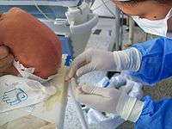

Slide 55
Role of a nurse cont….
After procedure:
Apply brief pressure to puncture site: using a bandage to avoid bleeding
Position: place patient on a flat bed: for 4 to 6 hours, do not elevate the head.
Monitor vitals, neurologic status, input & output: every 4 hours
Monitor puncture site for CSF leakage and drainage of blood: signs include positional headache, nausea and vomiting, neck stiffness, photophobia, imbalance, tinnitus& phonophobia (sensitivity to sound)
Encourage increased fluid intake: up to 3000mls in 24 hours to replace drawn CSF
Label and number specimen tube correctly and send to the lab
Analgesia: administer as ordered due to headaches after procedure

Slide 56
CSF tubes
Different institutions have different protocols for the studies sent from the various CSF tubes. Classically, CSF tubes 1-4 are sent for the following studies: 1 - Cell count and differential 2 - Glucose and protein levels 3 - Gram stain, culture and sensitivity (C&S) 4 - When indicated, viral titer or cultures, Venereal Disease Research Laboratory (VDRL) test, Cryptococcus antigen, India ink stain, angiotensin-converting enzyme (ACE) level, or other studies.

Slide 57
Abnormal findings:
Pressure:
Increased ICP as a result of tumor, hemorrhage, hypo-osmolality resulting from hemodialysis, or TB-meningitis or trauma induced edema
Decreased ICP: may reveal spinal subarachnoid obstruction, leakage of spinal fluid, severe dehydration, hyper osmolality, or circulatory collapse
Appearance:
Cloudy appearance=infection
Yellow to reddish- spinal cord obstruction or intracranial hemorrhage.
Brown to orange- increased protein levels or RBC breakdown.

Slide 58
Abnormal findings cont….
CSF protein:
Increased protein-tumor, trauma, Dmor blood in CSF.
Decreased protein- rapid CSF production.
Gamma globulin:
Increased Gg- demyelinating diseases e.g.multiple sclerosis, neurosyphilis or Guillan-Barre syndrome.
CSF glucose:
Increased-hyperglycemia
Decreased-hypoglycemia, bacterial or fungal infection, TB or meningitis

Slide 59
Abnormal findings cont….
CSF cell count:
Increased WBC- meningitis, tumor, abscess, acute infection, stroke, demyelinating disease.
RBC in CSF- bleeding into spinal fluid or result of traumatic lumbar puncture.
CSF chloride:
Decreased- infected meninges
Gram stain:
Gram positive or negative organism indicates bacterial infection.

Slide 60
Complications
Post lumbar puncture headache:
Due to leakage of CSF and reduction in the brain, it’s the most frequent complication in 11-25% of patients.
It may be mild or severe(throbbing frontal or occipital).
It may occur a few hours later or after several days.
It’s severe when the patient stands and reduces when they lie down.
Management:
Bed rest
Analgesics
Hydration with liberal administration of fluids especially those that contain caffeine E.g. coffee, tea, some sodas

Slide 61
Prevention of leakage
Needle with a small gauge should be used for puncture
Patient should remain prone for 3hrs, If larger amounts of CSF has been withdrawn(more than 20mls) then the patient should lie:
Prone for 2hrs
Lateral for 2hrs
Prone or supine for 6hrs

Slide 62
Complications cont….
B)Herniation of cranial contents
C)Abscesses : collection of pus in tissues causing swelling and inflammation around it.
D)Hematomas : localized collection of blood within tissues
E)Meningitis
F) Back pain: trauma to soft tissue

Slide 63
PLAY VIDEO

Slide 64
URINARY BLADDER IRRIGATION

Slide 65
Types
Intermittent (done for a short while with an intermittent catheter)
Continuous (for a long period of time using a 3-way catheter)

Slide 66
Continuous bladder irrigation(CBI)
Purpose:
Prevent blood clot formation
Allow free flow of urine
Maintain indwelling catheter patency

Slide 67
CBI cont…..
Expected outcomes:
The catheter remains patent and urine is able to drain.
Patients comfort is maintained
Prevention of clot formation within bladder and indwelling catheter(IDC).
Prevent risk of UTI through aseptic technique during insertion and connection of catheter.

Slide 68
CBI cont…..
Equipment:
3-way catheter
0.9% sodium chloride
CBI set and enclosed urine bag with anti-reflux valve
Non-sterile gloves
Personal protective equipment
Under pad
I.V pole/drip stand

Slide 69
Procedure:
Students to do SDL on this topic

Slide 70
Ongoing management:
Continue irrigation depending on hematuria degree
After every i.v bag is complete, empty urine bag. Record output on chart prior commencement of another i.v. bag.
Perform regular catheter care to minimize UTI,and document in cardex.
Document : catheter care, degree of hematuria, I/O
If output is less than input:
Stop infusion and re-calculate I/O
Ensure tubing is not kinked or looped below bladder level
Palpate bladder for distension as routine assessment

Slide 71
Ongoing management cont….
If there increased hematuria and clots:
Increase rate of irrigation
Irrigate catheter to aid in clot removal
Notify physician
If patient complains of pain:
Palpate for distention
Check tubing for kinks
Observe drainage for adequate amount, presence of clots that may be blocking tube, check I&O

Slide 72
Ongoing management cont…
If patient is confused/agitated:
Assess orientation
Notify physician on changes in LOC
Share with physician information on: opiods received, amount of CBI received, accurate I&O, time of onset of ALOC
If solution leaks:
Assess for bladder spasms
Consider administering antispasmodic(buscopan)

Slide 73
Documentation:
Patients pain/comfort level
Color and type of drainage, presence of clots
I&O
Interventions
Health education to patient and family
Patients concerns
Adverse reactions (continued bladder spasms, decreased total urine output)

Slide 74
CHOLECYSTOGRAM/CHOLECTOGRAPHY
This is an x-ray procedure used to help evaluate gall bladder.
For the procedure, a special contrast media is given in form of tablets which are swallowed to help visualize the gall bladder on x-ray.
The test helps diagnose disorders of the liver and gall bladder including tumors and gall stones
Contrast media used:
It’s oral and it’s given according to the manufacturer’s instructions. They include:
Orablix
Telepaque
Biloptin

Slide 75
Procedure preparation
Contrast media is given the evening before, ensure it’s not vomited(usually 6 tablets and shouldn’t drink anything there after)
An enema is given the night before to clear gas and faeces
A day before test give fatty meal, evening give low fat meals
Procedure
When contrast media tablets are given they are absorbed from intestines into the blood stream, removed from blood by liver, and excreted by liver into the bile.

Slide 76
The contrast media together with the bile is highly concentrated in the gall bladder, contrast media outlines the gall stones that are radiolucent(x-ray pass through them), and that are usually invisible on standard x-ray
Bile ducts themselves can not be seen on the x-ray in oral cholecystogram (OCG) because the contrast media is not concentrated on the ducts, therefore , any gallstones lodged in the ducts will go undetected on OCG
Depending on how well the contrast dye is absorbed, polyps and tumors may also be visible on x-ray film.

Slide 77
Note
Due to development of improved technology, cholecystogram is no longer performed routinely, ultrasound and CT scan are faster and often more accurate in diagnosing conditions of the gall bladder
Gall stones are usually seen as dark spots on x-ray films
After procedure care
Advise patient to drink a lot of water to flush out the dye from their system

Slide 78
CHOLANGIOGRAPHY
Cholangiography is the imaging of the bile duct (also known as the biliary tree) by x-rays. There are at least two kinds of cholangiography:
1. Percutaneous Trans-hepatic Cholangiography (PTC): Examination of liver and bile ducts by x-rays. This is accomplished by the insertion of a thin needle into the liver carrying a contrast medium to help to see blockage in liver and bile ducts.

Slide 79
2. Endoscopic Retrograde Choledochography (ERC).
This primarily examines the larger bile ducts within the liver and the bile ducts outside the liver
The contrast media is given intravenously
The procedure is used is to locate gall stones within the bile ducts and identify other causes of obstruction to the flow of bile. E.g strictures of bile ducts and cancers that may impair normal flow of bile

Slide 80
Procedure
To do an intravenous cholangiogram, an iodine containing dye is injected intravenously into the blood
The dye is removed from the blood by the liver which excretes it into bile.
The dye is concentrated enough just as it’s secreted into the bile that it does not need to be further concentrated by the gall bladder in order to outline bile ducts and any gall stones that may form within them.
several x-rays (radiographs) are taken as the liver excretes the dye

Slide 81
ERCP
Endoscopic retrograde cholangio-pancretography (ERCP) is a technique that combines the use of endoscopy and fluoroscopy(x-ray beams are used to show continuous image on a monitor) to diagnose and treat certain problems of the biliary or pancreatic ductal systems.
Through the endoscope, the physician can see the inside of the stomach and duodenum, and inject dyes into the ducts in the biliary tree and pancreas so they can be seen on x-rays.

Slide 82
ERCP is used primarily to diagnose and treat conditions of the bile ducts, including gallstones, inflammatory strictures (scars), leaks (from trauma and surgery), and cancer.
ERCP can be performed for diagnostic and therapeutic reasons, although the development of safer and relatively non-invasive investigations such as magnetic resonance cholangio-pancreatography (MRCP) and endoscopic ultrasound has meant that ERCP is now rarely performed without therapeutic intent.

Slide 83
Diagnostic indications
Obstructive jaundice - This may be due to several causes
Chronic pancreatitis - a now controversial indication due to widespread availability of safer diagnostic modalities including endoscopic ultrasound, high-resolution CT, and MRI/MRCP
Gallstones with dilated bile ducts on ultrasonography
Bile duct tumors
Suspected injury to bile ducts either as a result of trauma or iatrogenic
Sphincter of Oddi dysfunction
Pancreatic tumors no longer represent a valid diagnostic indication for ERCP unless they cause bile duct obstruction and jaundice. Endoscopic ultrasound represents a safer and more accurate diagnostic alternative

Slide 84
Therapeutic indications
Any of the above when the following may become necessary
Endoscopic sphincterotomy (both of the biliary and the pancreatic sphincters)
Removal of stones
Insertion of stent(s)
Dilation of strictures (e.g. primary sclerosing cholangitis, anastomotic strictures after liver transplantation)

Slide 85
Contraindications
Recent attack of acute pancreatitis, within the past several weeks.
Recent myocardial infarction.
Inadequate surgical back-up
History of contrast dye anaphylaxis
Poor health condition for surgery.
Severe cardiopulmonary disease.

Slide 86
complications
The major risk of an ERCP is the development of pancreatitis which can occur in up to 5% of all procedures.
Gut perforation is a risk of any endoscopic procedure, and is an additional risk if a sphincterotomy is performed. As the second part of the duodenum is anatomically in a retroperitoneal location (that is, behind the peritoneal structures of the abdomen), perforations due to sphincterotomies are also retroperitoneal.
Bleeding.
Oversedation can result in dangerously low blood pressure, respiratory depression, nausea, and vomiting.
There is also a risk associated with the contrast dye in patients who are allergic to compounds containing iodine.

Slide 87
Retrograde pyelograghy
Is a radiologic technique of examining strictures of the collecting system of the kidney
A radio opaque contrast medium is injected through a urinary catheter into the ureter and the calyces of the pelvis of the kidney using cytoscope
Indications
Incases where IVP provides inadequate visualization
Before extracorporeal shock-wave lithotripsy(to break kidney stones)
Identification of filling defects E.g. kidney stones and tumors
During replacement of ureteral stents

Slide 88
Contraindication
Presence of infected urine
Pregnancy
Allergy to contrast media
Complications
Infection
Perforation of ureter
haematuria

Slide 89
Myelogram/myelography
This is a radiologic examination that uses contrast medium to detect pathology of the spinal cord, including location of spinal cord injury, cysts and tumors
The procedure involves injection of radio opaque dye into cervical or lumbar spine followed by several x-ray projection
A myelogram may help find the cause of pain not found by an MRI or CT scan

Slide 90
Indications
The cause of leg or arm numbness, weakness or pain
Narrowing of the spinal canal(spinal stenosis)
Tumor or infection causing problems with the spinal cord or nerve roots
A spinal disc that has ruptured (herniated disc)
Inflammation of the membrane covering the brain and spinal cord
Problems with blood vessels to the spine

Slide 91
Pre procedure care
Explain the procedure to the patient
Obtain a signed consent
Starve the patient before the procedure for the prescribed time
Remove dentures and metal ornaments or objects
Procedure
Patient lies prone on the x-ray table with lower extremities tightly secured with straps to the table
Skin area is infiltrated with local anaesthesia, dye is then injected into the spinal sac, then the table is slowly rotated into circular motion

Slide 92
First down at the head end for 4-6 minutes then rotated up at the head end for the same duration
Several more minutes the process is completed. This movement ensures the contrast has sufficiently worked it’s way through the spinal cord, followed by x-rays, CT or MRI scans
If the dye introduced in spinal tap was oil based, the physician conducting the procedure will remove it after the procedure. If water based dye is used it’s not removed as it is eventually absorbed by the body

Slide 93
Post procedure care
Patient should be in recumbent position for 24hrs with head raised
Observe for neurologic signs especially headache as a result of CSF leakage
Encourage the patient to increase fluid intake to enhance dye excretion
Instruct the patient to avoid strenuous activities and heavy lifting at least a day after test

Slide 94
Assignment:
Hysterosalpingogram:
Role of a nurse before and after procedure
Steps in performing procedure

Slide 95
ENDOSCOPY

Slide 96
ENDOSCOPY
This is the use of a hollow instrument to look inside the body cavities or organs . It uses flexible tube that has a small (camera)on the end of it.
The instrument is referred to as an endoscope
An endoscope is passed through a natural body opening or via a small incision. For example a laparoscope is inserted through small surgical incision in the pelvic or abdominal area
If an ultra-sound probe is added to endoscope E.g. GIT endoscope this is called endoscopic ultrasound

Slide 97
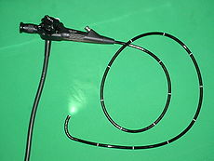
A flexible endoscope

Slide 98
BRONCHOSCOPY

Slide 99
BRONCHOSCOPY
This is the direct inspection and examination of larynx(laryngoscopy), trachea and bronchi through a flexible or rigid bronchoscope
PURPOSES
DIAGONISTIC
Lung growth, lymph nodes ,atelectasis or other changes seen on x-ray or imaging tests
Coughing up blood(haemoptysis)
Suspected interstitial lung disease
Cough that has lasted for more than 3months without any other explanation
To determine if a tumor can be removed surgically ( resected)
To obtain a tissue for biopsy
To diagnose lung rejection after lung transplant

Slide 100
Purpose cont..
THERAPEUTIC
To remove foreign bodies from the trachea
Remove fluid or mucus plugs from airways
Widen (dilate)blocked or narrowed airway
Drain an abscess
Treat cancer using a number of different techniques
Wash out an airway (therapeutic lavage)

Slide 101
NURSING ROLE
Before the procedure:
Informed consent to be signed by the patient
Starve patient 6-12hrs
Explain procedure to patient to allay anxiety
Advise patient to avoid aspirin, brufen and other anticoagulants before the procedure
Give pre-medication :
atropine 0.6mg-1mg(iv,sc,im)
sedative(diazepam 5-10mg) or narcotic analgesic to inhibit stimulation of the vagus nerve and prevent vomiting , suppress cough reflex ,sedate & relieve anxiety.
Dentures are removed and all artificial prothesis
Assist in spraying local anaesthesia if its to be used
If a rigid bronchoscope is used general anaesthesia is given

Slide 102
NURSING ROLE
After the procedure:
For an hour after the procedure observe patients vital signs
Monitor and report changes in breathing , chest pain or oxygen saturation levels ,hypertension , tachycardia, hemoptysis
Patient should be nil per oral until cough reflex and effects of local anaesthesia have worn off.
Cracked ice is given to suck, later fluid.
Observe for confusion and lethargy in elderly
When the patient is no longer experiencing effects of sedation they can be allowed to sit up

Slide 103
complications
Aspiration
Bronchospasm
Hypoxemia
Pneumothorax
Bleeding
Abrasion of lining of airways leading to swelling, inflammation and infection

Slide 104
PLAY VIDEO

Slide 105
OESOPHAGOSCOPY & GASTROSCOPY

Slide 106
UPPER GIT FIBRE (ENDOSCOPY)
Also called esophagogastroduodenoscopy(OGD). It visualizes the upper part of the GI tract up to duodenum
It’s a minimally invasive procedure since it doesn’t require an incision into one of the major body cavities and doesn’t require significant recovery after procedure (unless sedation or anaesthesia have been used)
It allows direct visualization of gastric mucosa thru a lighted endoscope for suspected gastric tumors and diseases , colored photos or motion pictures can also be taken
Mouth guard are used during the procedure to prevent the patient from biting the scope

Slide 107
OESOPHAGOSCOPY AND GASTROSCOPY
An esophagoscopy is a procedure to view the inside of the esophagus
Gastroscopy is a procedure to view inside of stomach
Duodenoscopy is a procedure to view duodenum .
These procedures are performed as a single procedure and are collectively referred to as an upper endoscopy or oesophagogastroduodenoscopy (OGD)

Slide 108
Purposes
Examine esophagus for ulcers and tumors
Taking biopsy
Removal of foreign bodies
Dysphagia(difficulty in swallowing) or odynophagia(painful swallowing)
Persistent nausea and vomiting
Dyspepsia(indigestion)
Acute upper GIT bleeding
Chronic anaemia/or iron deficiency anaemia after non gastro-intestinal origin has been eliminated.
Gastro-esophageal reflux with warning signs i.e. weight loss, dysphagia, bleeding and anaemia

Slide 109
Peptic ulcer disease
Role of a nurse before procedure:
Starve 6-8hrs(stomach must be empty for clear view)
Explain procedure
Gain informed consent
Vital signs
Narcotic analgesia is given 30minutes before
Patients throat maybe sprayed with local anaesthesia to help prevent discomfort, or they gargle local anaesthetic agent for mouth and throat or
IV diazepam 5-10mg is given just before the procedure
Atropine 0.6-1.0mg IM/IV is also given to reduce secretions
Organon 0.5-1.0mg IM is given to relax smooth muscles

Slide 110
Procedure
Local anaesthesia is sprayed in mouth or throat or sedation is done
Endoscope is then passed smoothly and slowly in the areas being examined
The procedure takes 10-20minutes
The doctor may inject moderate amount of air to expand the stomach allowing better visualization
Biopsy is taken for examination or images of the digestive tract are taken for documentation of any abnormality; esophageal varices can be banded, resecting or ablating mucosal tissue

Slide 111
After procedure care
Patient should not eat 3-4hrs after procedure until gag reflex returns to prevent aspiration
Observe for vital signs post procedure
Observe for signs of perforation E.g. pain, hematemesis
Minor throat discomfort may occur after procedure and last up to 24hrs, it can be relieved with lozenges, cool saline gargle or analgesics
Advise the patient to report any unusual or severe abdominal pain or bleeding following the procedure

Slide 112
Complications
Bleeding
Infection
Perforation
Cardiopulmonary problems
Adverse reactions to medications

Slide 113
LOWER GIT ENDOSCOPY
These are procedures for direct viewing of the lumen of the lower bowel using;
Anoscope ;- to examine the anal canal
Proctoscope ;- for the rectum
Sigmoidoscope ;- for the colon
Purpose
To check presence of ulceration, tumors, polyps, and lesions
To take a biopsy
Removal of polyps

Slide 114
Indications
Gastrointestinal problems such as unexplained bleeding
Persistent changes in bowel habits
Anaemia
Age 50yrs; 5yearly then 3 yearly
To diagnose colitis or colon/rectal cancer
Preparation
The patient should take only clear oral fluids and not to consume any food for at least 24hrs before the exam
Laxatives and enemas may be required before the start of exam to clear the lower bowel

Slide 115
Anoscopy & protoscopy

Slide 116
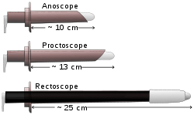

Slide 117
Anoscopy/proctoscopy
Procedure
Explain the procedure to the patient
Put the patient in knee chest position with feet beyond the edge of the bed, knees apart to give support, head resting on the couch, fore arms on either side of the head and hands placed one on top of the other above the head
The patient is told of the progress, the possibility he might feel like moving his bowel and thanked for co-operation

Slide 118
Suction may be done to remove secretions
Biopsy may be taken
Polyps may be removed and the area cauterized to prevent bleeding
The tissue removed is placed on moist gauze and then in the appropriate container, labeled , and sent to the pathology lab with the request form.
After each use the tubes are washed thoroughly
Disposable tubes should be disposed safely

Slide 119
Colonoscopy & Sigmoidoscopy

Slide 120
Colonoscopy/ sigmoidoscopy
This is endoscopic examination of the large bowel and distal part of the small bowel with an endoscope passed through the anus.(colonoscope)
The colonoscope has a small camera attached to a flexible tube that can reach and examine the entire length of the colon.

Slide 121
Indications
Diagnostic:
Colon cancer, inflammatory bowel disease, GIT haemorrhage, ulceration, polyps, and removal of biopsy; changes in bowel habit(unexplained).
Prophylactic:
Removal of polyps
Therapeutic:
Removal of foreign bodies
Screening:
Every 10yrs from 50yrs for colorectal cancer

Slide 122
Patient preparation
Explain the procedure to the patient
Starve the patient of solid foods for 3 days to empty the GIT
Laxatives are given for two days
On day of examination an enema is given until rectum is clear
Narcotic analgesic may be ordered and administered
Diazepam is given to sedate the patient

Slide 123
Procedure
Sigmoidoscopy; position the patient in knee chest
Colonoscopy; the patient lies on left side with legs drawn up
The first step is usually a digital rectal examination to examine the tone of the anal sphincter and to determine if the preparation is adequate
Patient is sedated, the endoscope is then passed through the anus up the rectum and colon(sigmoid, descending, transverse, and ascending colon, the caecum) and ultimately the terminal ileum

Slide 124
The bowel is occasionally inflated with air to maximize visibility(procedure that may give false sensation of need to have a bowel movement)
Biopsies are then taken for histology or examination and diagnostic evaluation of colon is done.
Post procedure care
Advise the patient to refrain from operating heavy machinery until a day after the procedure
The patient resumes other normal activities after effects of sedation wear off E.g. eating and drinking normally
Advise patient to report signs of, chills, fever, rectal bleeding(more than a tablespoon) swelling or redness at IV site or severe abdominal pain or bloating

Slide 125
Mild abdominal pain and bloating is expected after the procedure
Complications
Perforation
Haemorrhage
Inflammation of the bowel

Slide 126
cystoscopy

Slide 127
Cystoscopy
This is endoscopy of the urinary bladder via the urethra
A cytoscope is used
Diagnostic cystoscopy is carried out using local anaesthesia, GA is sometimes used for operative cystoscopic procedures.
To enable clear visualization, sterile irrigation solution is instilled to distend the bladder and wash away any clots.

Slide 128
Indications
Urinary tract infections
To assess the ureter and kidney pelvis
Haematuria
Incontinence( loss of bladder control)
Unusual cells found in urine sample
To remove renal calculi(kidney stones)
Urinary blockage E.g. prostate enlargement and stricture
Unusual growth, polyp, tumor or cancer and obtain biopsy

Slide 129
Patient preparation
Explain the procedure to the patient
Patient may take 1-2 glasses of water (or as instructed) before going for the examination
They should not urinate for a sufficient period of time, such that they are able to urinate prior to the procedure
Procedure
Patient lies on their back(supine) with their knees slightly apart, they may also need to flex their knees especially when doing rigid cystoscopy examination.
For flexible cystoscopy , local anaesthesia is used
Local anaesthesia is applied directly from a tube or needleless syringe into the urinary tract

Slide 130
The doctor gently inserts the tip of the cytoscope into the urethra and slowly guide it up the bladder
The procedure is more painful for men than women due to length and narrow diameter of the male urethra, relaxing pelvic muscles helps ease this pain
A sterile liquid(water, saline, glycine solution) will flow through the cytoscope to slowly fill the bladder and stretch it so that there is a better and clear view of the bladder wall
The procedure takes 15-20 minutes
Flexible cystoscopy(just to look inside the bladder), Rigid cystoscopy(if you need treatment for a problem in the bladder).

Slide 131
After procedure care
Relief of expected discomfort i.e burning and frequency of micturation by encouraging patient to increase oral fluid intake
Warm bath or compresses also relieves the burning feeling
Incase of blood tinged urine –relieve this by application of moist heat to the lower abdomen
Warm sitz bath are also recommended for urinary retention from edema
An indwelling catheter may have to be inserted

Slide 132
Play video

Slide 133
COMPUTED TOMOGRAPHY

Slide 134
Computed tomography
Computed tomography (or computerized axial tomography) is an examination that uses X-ray and computer to obtain a cross-sectional image of the human body.

Slide 135
Computed tomography
When X-rays are irradiated on the human body, some of the rays are absorbed and some pass through the body to produce an image.
In plain X-ray imaging, the film directly absorbs penetrated X-rays. In CAT scanning, an electronic device called a "detector array" absorbs the penetrated X-rays, measures the X-ray amount, and transmits the data to a computer system.
A sophisticated computer system, in turn, calculates and analyzes data from each detector in each level, and finally reconstructs multiple, two-dimensional, cross-sectional images.

Slide 136
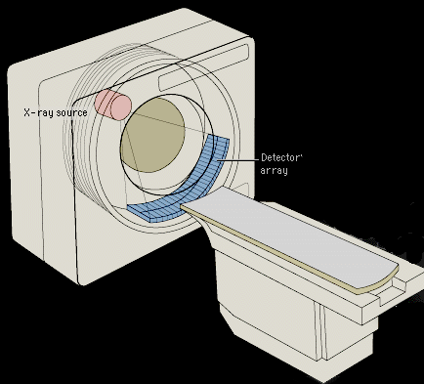

Slide 137
Nurses role:
Before procedure:
Obtain informed consent
Look for allergies: to iodine or shellfish
Obtain health history: recent illness, medical conditions, current medications.
NPO status: not to eat or drink prior procedure especially if contrast media will be used.
Dressing up: wear comfortable, loose fitting clothing.
Information about contrast medium: inform there will be mild pain from needle puncture and flushed sensation while injecting the medium I.V.
Instruct patient to remain still during procedure but should report itching, D.I.B., dysphagia, nausea and vomiting, dizziness and headache.
Inform patient duration of the procedure: 5minutes to 1 hour depending on type of CT scan
Remove all jewelry and dentures.
Vital signs

Slide 138
Nurses role:
After procedure:
Diet as usual: resume diet and activities as usual
Fluid intake: increase fluid intake if contrast was given to promote excretion of dye.

Slide 139
Contraindications:
Pregnant patient
Known iodine allergy
Patients with claustrophobia
Patients with renal impairment, unless benefits outweigh the risks.
Patients with hyperthyroidism or toxic goiter
Patients with complications after previous contrast administration
Patients with severe obesity

Slide 140
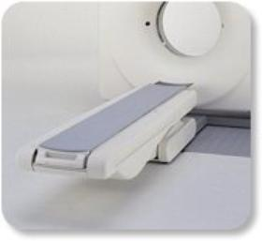
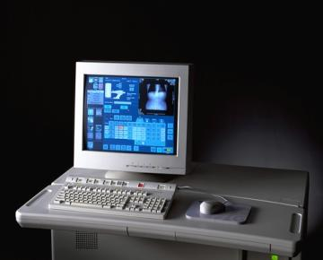
Computed tomography
Gantry and Table
Operation console

Slide 141
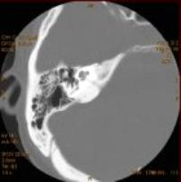
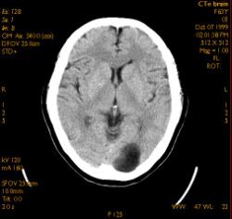
Computed tomography

Slide 142
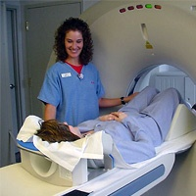
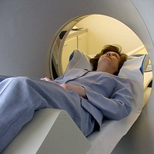
Computed tomography
Feet first
Head first

Slide 143
Computed tomography
Risks
Iodine is the usual contrast dye. Some patients are allergic to iodine and may experience a reaction that may include nausea, breathing difficulty, or other symptoms.
The amount of radiation used during a CT procedure is considered minimal; therefore, the risk for radiation exposure is very low.
Radiation exposure during pregnancy may lead to birth defects.

Slide 144
Before the Procedure
Explain the procedure to the patient.
If the procedure involves the use of contrast dye, consent should be signed from the patient.
Ask the patient if he has ever had a reaction to any contrast media.
Generally, there is no fasting requirement prior to a CT scan, unless a contrast media is to be used. (abdomen and pelvis need fasting and cleaning the colon – iv contrast need fasting 4 hours before the examination).

Slide 145
CAT scan examination
CT angiography
Dynamic CT
CT Diffusion and perfusion
High resolution technique
CT fluoroscopy
Virtual real endoscopy

Slide 146
CT Scan of the Brain
An imaging technique of the brain that reveal tumors, blood clots, hemorrhages, or other abnormal anatomy.
A series of computerized images of the brain at various levels are taken to reveal normal anatomy or any abnormality.

Slide 147
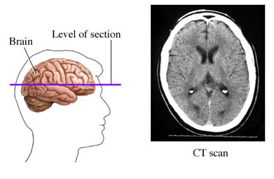
CT Brain

Slide 148
CT Brain
A CT scan is recommended to help:
Evaluate acute cranial-facial trauma
Determine acute stroke
Evaluate suspected subarachnoid or intracranial hemorrhage
Evaluate headache
Determine if there abnormal development of the head and neck

Slide 149
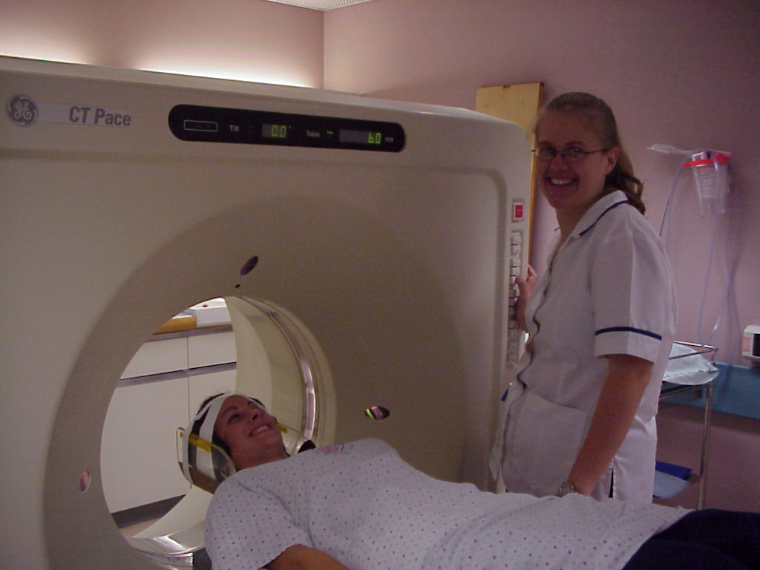
CT Brain
Positioning
Supine
Arms along the sides of the body
Head immobilized in the head holder

Slide 150
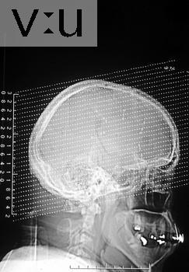
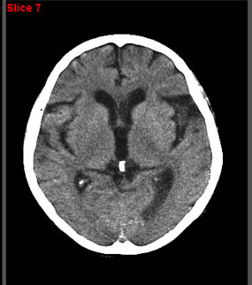
CT Brain

Slide 151
Possibility of fracture
CT Bone
Two films are printed :
The 1st is soft tissue.
The second is bone window.

Slide 152
CT of the neck
Patient preparation:
Fasting for 3Hours before the examination
Contrast:
Depend on the examination
100-150 ml nonionic contrast medium (omnipaque 300) Bolus injection of the contrast for spiral CT

Slide 153
Positioning:
Supine
Arms along the sides of the body
Immobilization of the head
Parameters:
Starting at floor of the mouth
Ending at supraclavicular fossa
Respiration suspended in expiration with no swallowing.

Slide 154
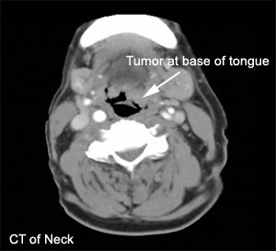
Computed tomography

Slide 155
CT scan of the chest
Computed tomography

Slide 156
CT Chest
Patient preparation:
Fasting for 3Hours before the examination
Chest x-ray in two projection
Positioning:
Supine
Arms folded behind the head

Slide 157
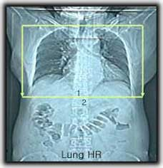
CT Chest
Parameter:
Starting at the lung apex
Respiration suspended in inspiration

Slide 158

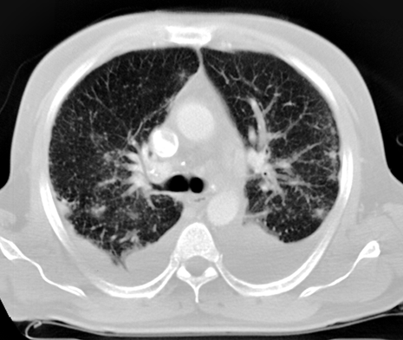
Mediastinal window
CT Chest
Lung window

Slide 159
CT Scan of the Abdomen

Slide 160
Certain factors or conditions may interfere with the accuracy of a CT scan of the abdomen. These factors include:
metallic objects within the abdomen, such as surgical clips
barium in the intestines from a recent barium study
stool and/or gas in the bowel
CT Abdomen
Notes:
160

Slide 161
CT Abdomen
Patient preparation:
Fasting 4-6 hours before the examination
Radiologist sometime needs abdominal U.S
Oral laxative must be given
I/V buscopan is required at the time of examination
Any metallic foreign must be removed
Preferably the patient should be in hospital gown

Slide 162
CT Abdomen
Contrast Media:
Oral contrast
At mid night before the day of the examination .800ml of contrast media (5% Gastrografin + 95% water), the patient asked to drink 700ml during these hours
The last 100ml immediately before the exam
Replaced now by oral water and mannitol.
I.V. contrast
100 ml nonionic contrast (omnipaque 300)

Slide 163
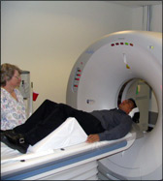
Computed tomography

Slide 164
CT Abdomen
Non contrast CT of the abdomen include
Urinary tract evaluation (stone protocol )
Emergency CT for appendicitis
Abdominal trauma

Slide 165
CT for lumbar spine

Slide 166
CT Lumbar spine
Patient preparation:
For routine test no preparation
Contrast:
No contrast in routine examination

Slide 167
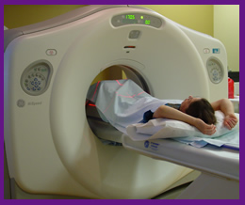
Computed tomography

Slide 168
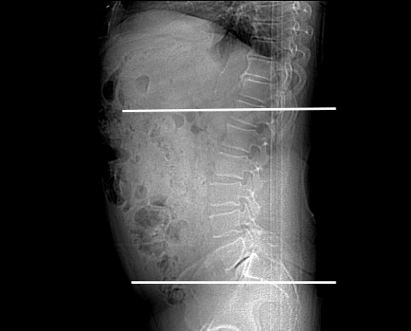
CT Lumbar spine
Positioning:
Supine and feet first
Arms above the head
The knees flexed 30º
Parameters:
Starting at xiphoid process
Ending at the level of hip joint
Respiration suspended in expiration

Slide 169
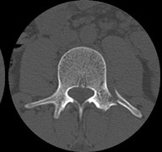
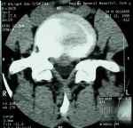
CT Lumbar spine
Bone window
Soft-tissue window

Slide 170
MAGNETIC RESONANCE IMAGING (MRI)

Slide 171
MRI
Magnetic resonance imaging (MRI) is an imaging technique used primarily in medical settings to produce high quality images of the soft tissues of the human body.
It is based on the principles of nuclear magnetic resonance (NMR), a spectroscopic technique to obtain microscopic chemical and physical information about molecules
MRI has advanced beyond a tomographic imaging technique to a volume imaging technique

Slide 172
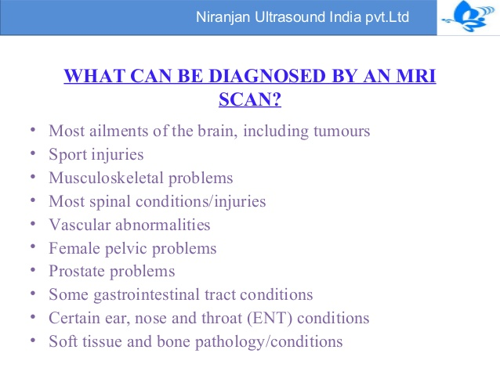

Slide 173
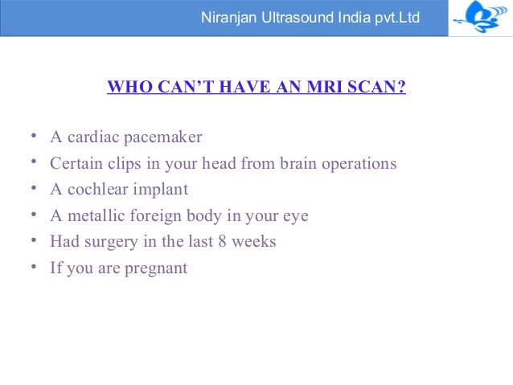

Slide 174
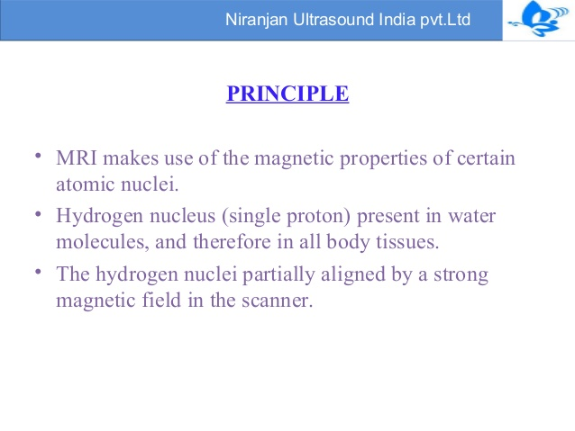

Slide 175
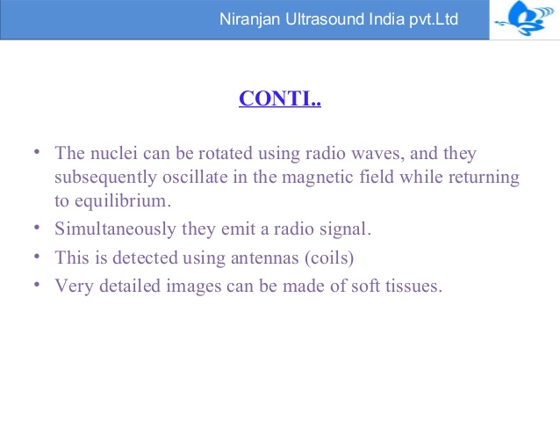

Slide 176
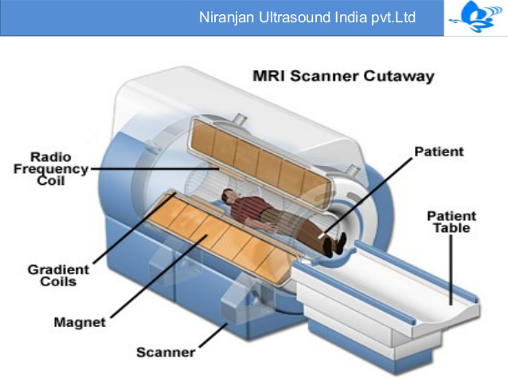

Slide 177
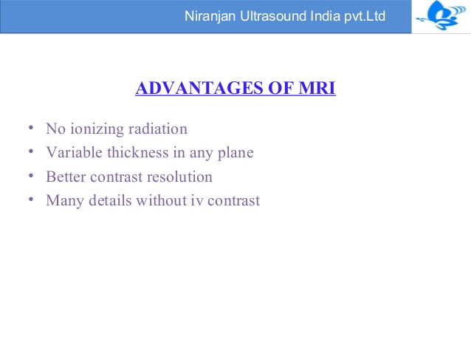

Slide 178
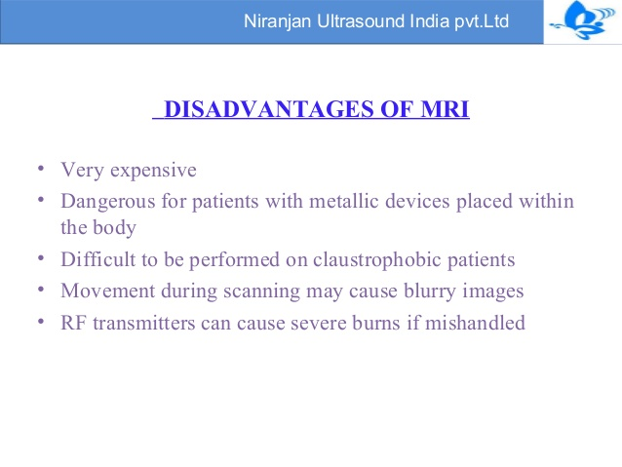

Slide 179
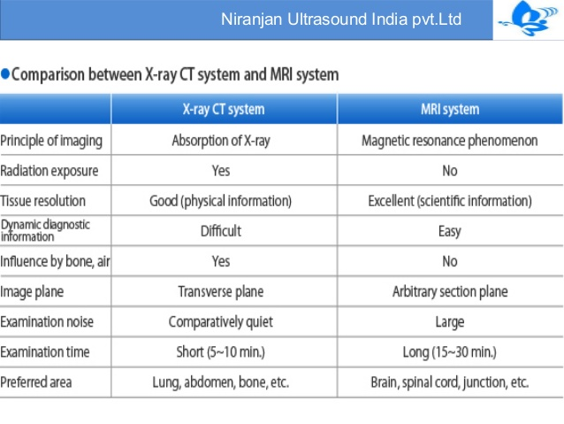

Slide 180
ELECTRO-ENCEPHALOGRAM(EEG)
Is a non invasive procedure that assesses the electrical activity of the brain.
The brain’s spontaneous electrical activity is recorded over a short period of time, 20-40 minutes from multiple electrodes placed on the scalp
The electrodes are connected to wires then a machine which records electrical impulses, the results are printed out or displayed on a computer monitor
Different patterns of electrical impulses can denote various form of neurological problems E.g. epilepsy

Slide 181
Indications
Evaluation of brain disorders
Determine brain death
To determine whether to wean off anti-epileptic medications
NOTE
most EEG show the type and location of the activity in the brain during a seizure thus evaluates people with problems associated with brain function E.g. confusion, coma, tumors, long term difficulties with thinking or memory, or weakness of specific parts of the body like in coma

Slide 182
Used to prove if some one on life support machine has no chance of recovery
Patient preparation
Head is shaved or patient avoids hair styling products on the day of exam
Tranquilizers and stimulants are with held for 24-48 hours
Drinks that are stimulants are also withheld E.g. coffee, tea, cola etc.
Explain the procedure to the patient i.e. takes 45-60 minutes, doesn’t cause electric shock, it’s a test not a form of treatment

Slide 183
Procedure
Patient lies on the table, about 16-20 electrodes are attached to the scalp with a conductive gel or paste
Each electrode is attached to an individual wire
Electrode location and names are specified by the international 10-20 system
The patient is asked to relax, lies with eyes open, then later with eyes closed
The patient may be asked to breath deeply and rapidly or stare at a flashing light, these activities produces changes in the brain wave patterns.
If being evaluated for sleep disorder, EEG may be performed continuously through out the night when the patent is sleeping.

Slide 184
The brain’s electrical activity is recorded continuously through out the exam on special EEG paper.
EEG results are interpreted by a neurologist
After procedure care
Instruct the patient when to resume medications especially anti-seizure medications that had been with held
Patient doesn’t require recovery time but instruct them to report to hospital if;
Number of seizures increase
An altered mental status
Having new loss of function

Slide 185
ELECTROCARDIOGRAPHY(ECG)
Is a test that records the electrical activity of the heart, it’s used to detect and locate the source of heart problems
It shows the heart rate, rhythm and records the strength and timing of the electrical signals as they pass through each part of the heart
Purpose
Measure the rate and regularity of the heart beats
Size and position of the heart chambers
Presence of any damage to the heart
Effects of drugs or devices used to regulate the heart E.g pacemaker

Slide 186
Indications
Symptoms of myocardial infarction
Symptoms of pulmonary embolism
Cardiac murmurs
Syncope or collapse
Seizures
Perceived cardiac dysrhythmias
Assessing patients with systemic diseases
Monitoring during anaesthesia and critically ill patients

Slide 187
Patient preparation
Explain the procedure to the patient
Patient should avoid exercising or taking cold water immediately before ECG as this may give false results
Shaving hair where electrode will attach
Procedure
The technician attaches 12 soft patches called electrodes to the skin on the chest arms and legs
The patient lies still on the table in supine position while electrodes detect the electrical signals of the heart
A machine then records these signals on graph paper or displays them on the monitor
Entire test takes about 10 minutes , after the test the electrodes are removed from the skin and discarded.
Graph is interpreted and diagnosis established.

Slide 188
ASSIGNMENT:
X-RAYS(Chest, Bone, skull):
Role of a nurse before and after procedure
Steps in performing procedure

Slide 189
COLOSTOMY CARE

Slide 190
THE PERSON WITH AN OSTOMY
An Ostomy is the surgical creation of an artificial opening
The opening is called a stoma
A colostomy is the surgical creation of an artificial opening between the colon and the abdominal wall
An ileostomy is a surgically created opening between the small intestine and the abdominal wall

Slide 191
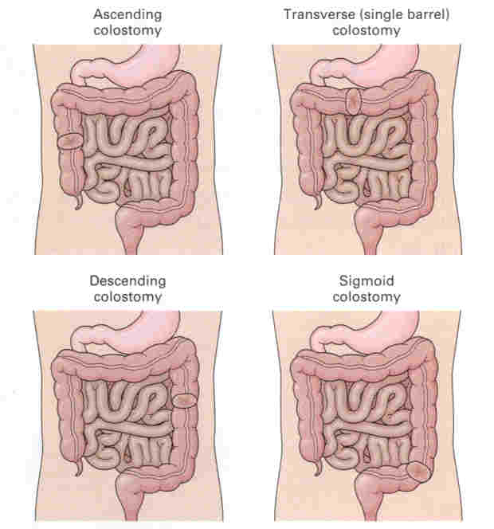
COLOSTOMY SITES

Slide 192
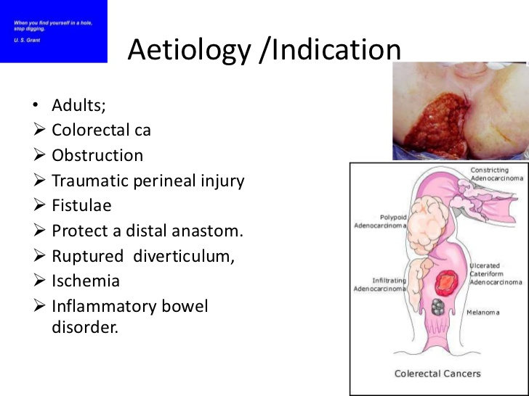

Slide 193
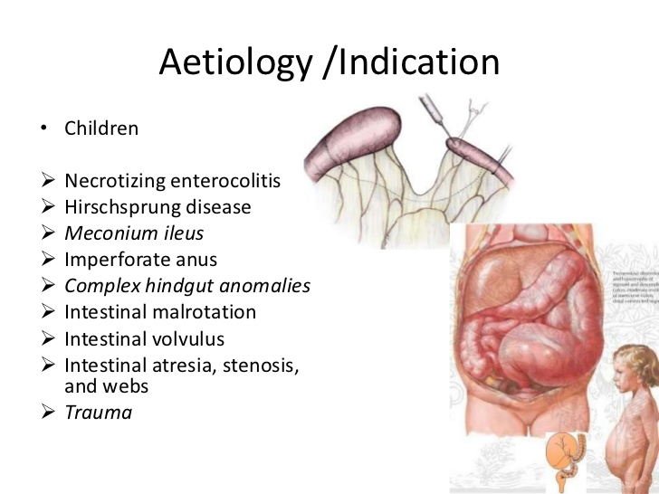

Slide 194
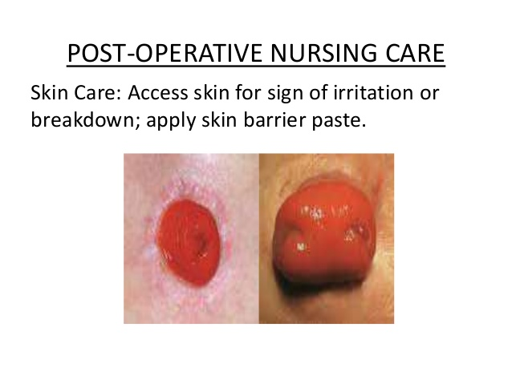

Slide 195
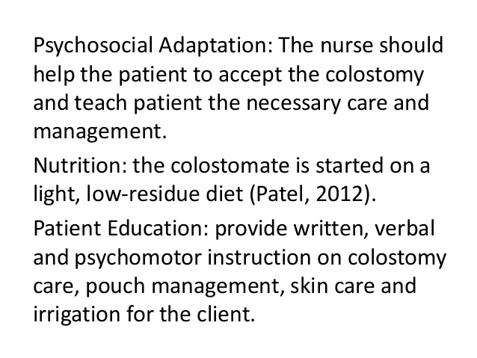

Slide 196
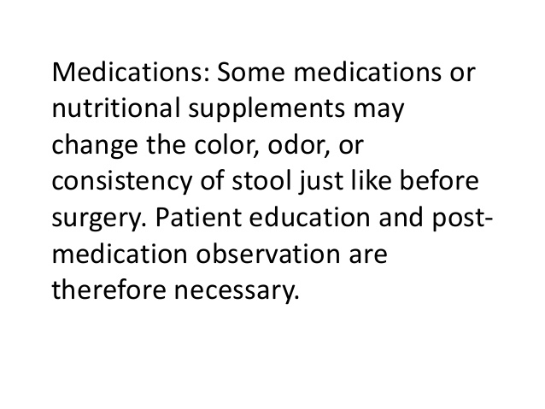

Slide 197
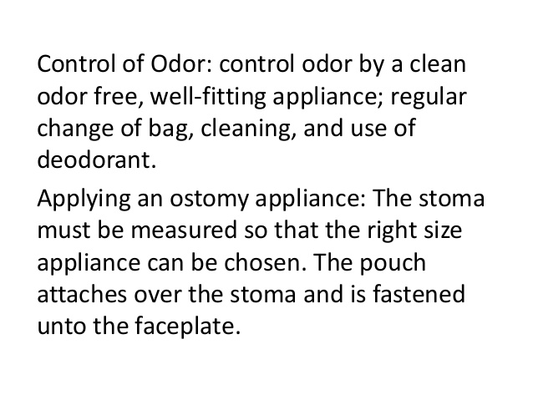

Slide 198
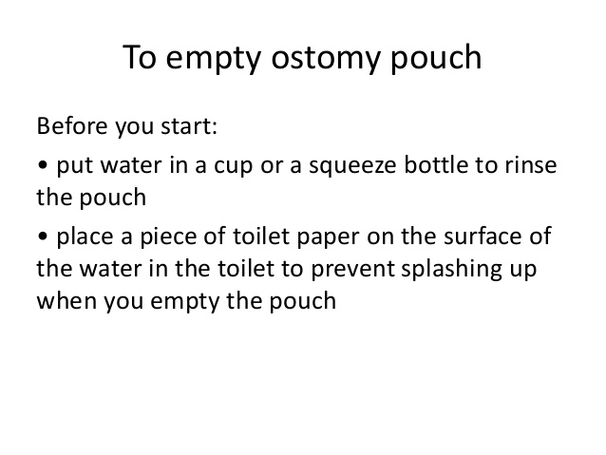

Slide 199
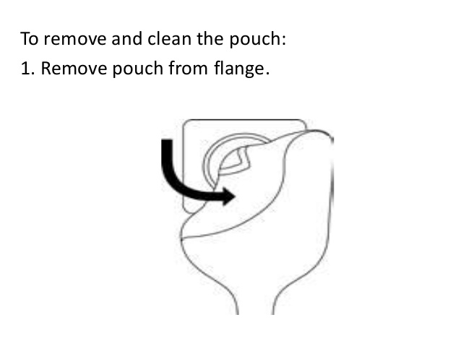

Slide 200
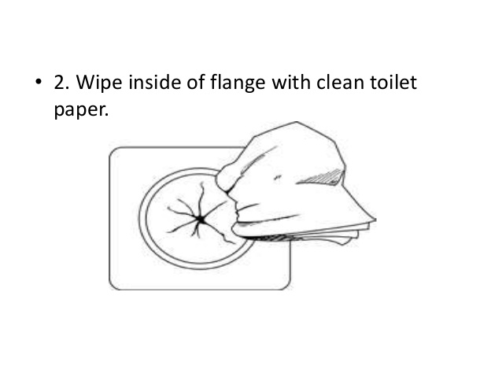

Slide 201
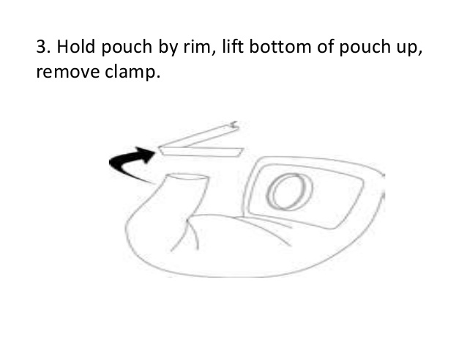

Slide 202
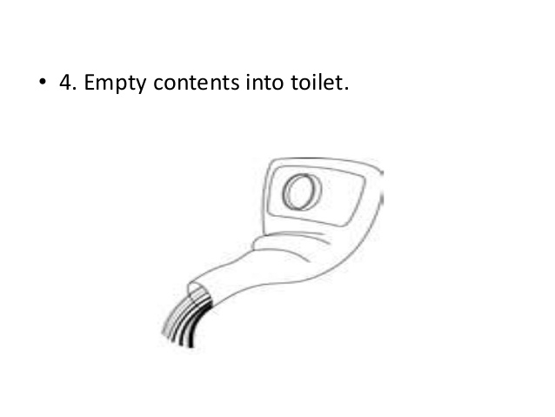

Slide 203
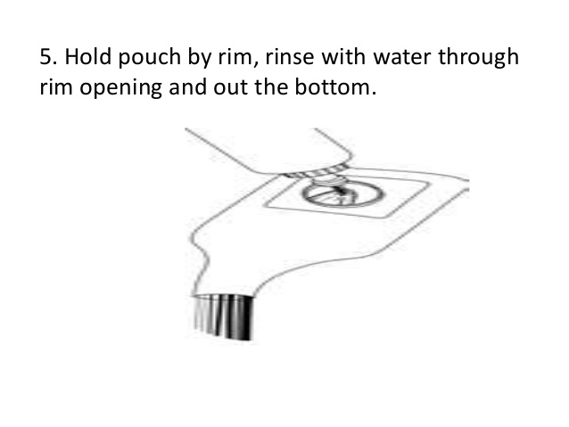

Slide 204
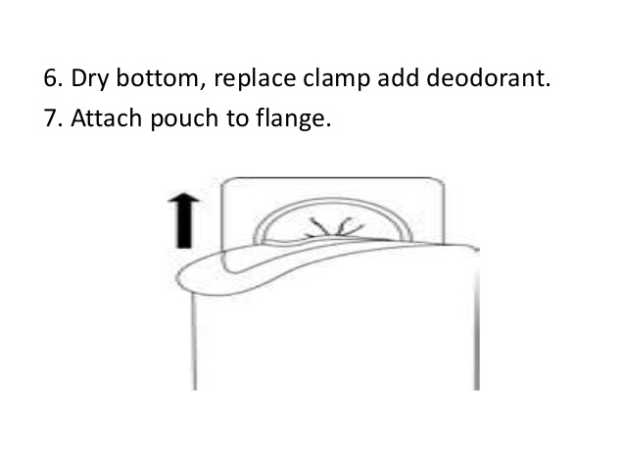

Slide 205
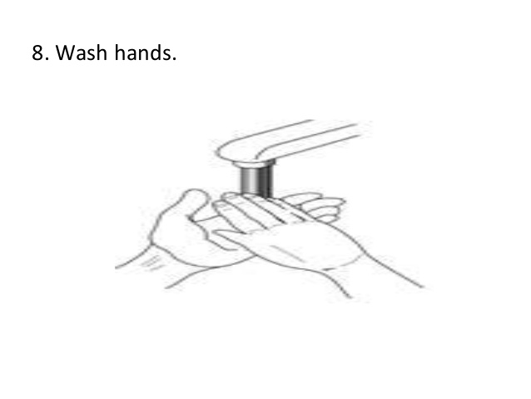

Slide 206
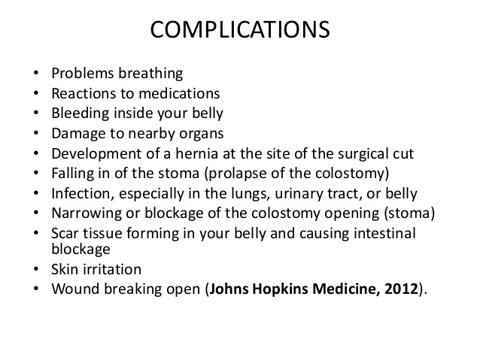

Slide 207
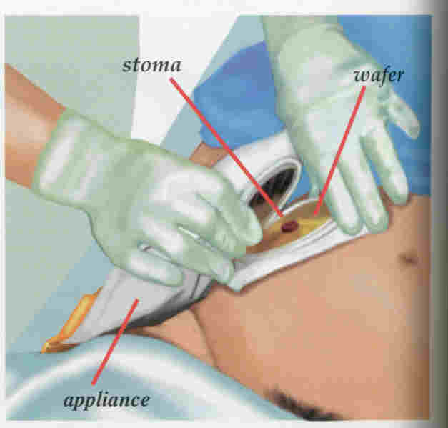
GENTLY REMOVE THE COLOSTOMY APPLIANCE (COLOSTOMY BAG) AND PLACE IT IN THE BEDPAN.

Slide 208
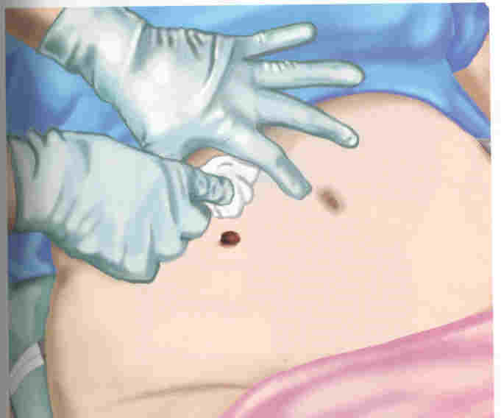
CLEAN AROUND THE STOMA WITH SOAP (MILD) AND WATER

Slide 209
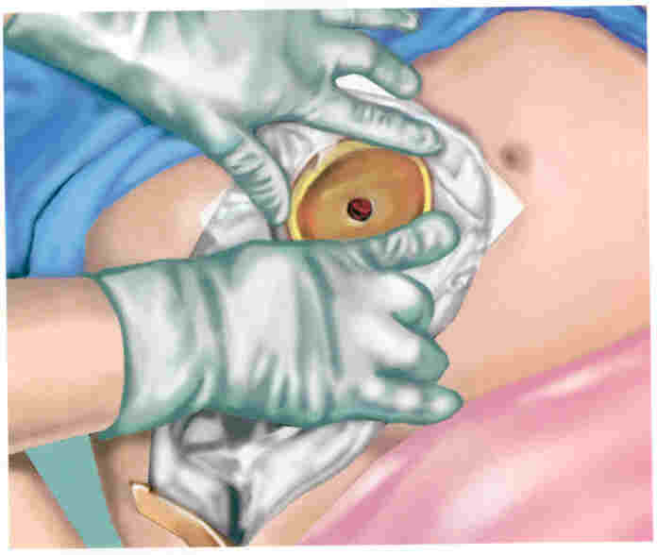
REMOVE THE ADHESIVE BACKING AND CENTER THE POUCH OVER THE STOMA. APPLY GENTLE PRESSURE.
FASTEN THE CLAMP AT THE BOTTOM OF THE BAG.
DEODORANT IS PLACED IN THE BAG TO PREVENT ODORS.
DO NOT LET THE PERSON SHOWER OR BATHE FOR 1-2 HOURS AFTER APPLYING THE POUCH.

Slide 210
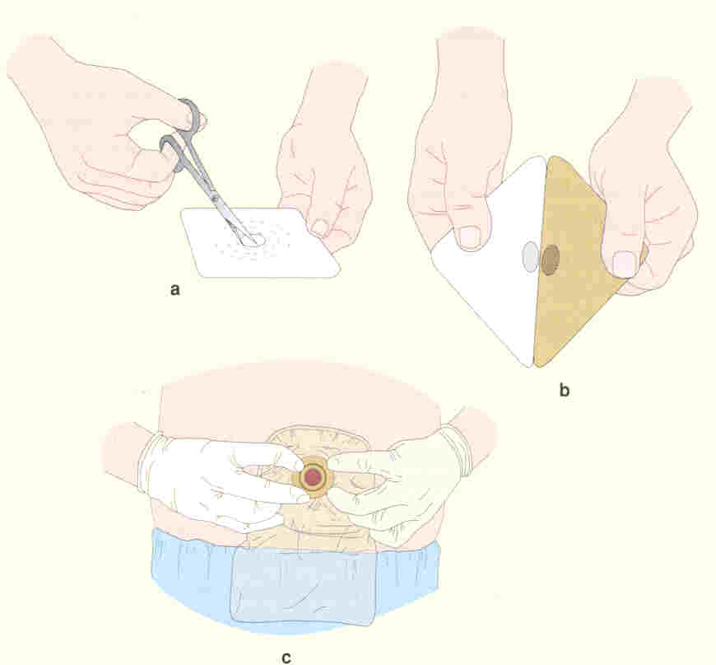
THE WAFER MAY HAVE TO BE CUT TO THE PROPER STOMA SIZE

Slide 211
URINARY CATHETERIZATION

Slide 212
OBJECTIVES
By the end of the lesson the learners will be able to describe the performance of urinary catheterization for male and female clients or patients.
Describe the performance of suprapubic catheter insertion

Slide 213
IMPORTANCE PRIOR KNOWLEDGE
Anatomy and physiology of urinary system
Rationale for procedure
Necessary equipment
Competence in performing skill

Slide 214
DEFINITION
Urinary catheterization is the process of inserting a catheter through the urethra into the urinary bladder for withdrawal of urine or instillation of drugs.

Slide 215


Principles of Catheterisation

Slide 216
Indications for catheterisation
Collection of urinary samples
Acute urinary retention or obstruction
Surgical procedures involving pelvic or abdominal surgery repair of the bladder, urethra and surrounding structures
In critically ill patients to monitor urinary output
Bladder irrigation following surgery
Instillation of drugs
To promote healing of perineal ulcers

Slide 217
Contraindications
Traumatic injury to the lower urinary tract (eg, urethral tearing) in women and men
Urinary tract infections

Slide 218
Equipment required
Sterile catheterisation pack containing gallipots, receiver, swabs, disposable towel
Disposable under pad for patient
Sterile gloves and disposable plastic apron
Appropriate catheter
Sterile anaesthetic lubricating jelly
Water for injections to inflate catheter balloon
Universal specimen container
Antiseptic solution
Drainage bag

Slide 219

TYPES OF CATHETERS

Slide 220
Catheter types short term
Catheter material | Duration | Comments
PVC –polyvinyl chloride | 14 days | Rigid, painful
Latex | 14 days | Can cause discomfort and tissue trauma due to high surface friction
Teflon-coated latex | 28 days | Smoother, resistance to encrustations

Slide 221
Catheter types longer term
Catheter material | Duration | Comments
Silicone elastomer-coated latex | 12 weeks | Resistance to bacterial adherence
Silicone | 12 weeks | Smooth, resistance to encrustations, non-inflammatory
Hydrogel-coated latex | 12 weeks | Resistance to bacterial adherence, improved patient comfort, non-inflammatory

Slide 222
Catheter sizes
Catheters are available in both different sizes and lengths
Variation in length is due to the difference in length of the male and female urethra
Male catheters are 41- 45cm in length
Female catheters are 20- 25cm in length

Slide 223
Cont. sizes
The size is the diameter of the internal lumen of the catheter and is measured in Charriere (Ch) named after its French inventor
The most common sizes are 10F(3.3mm) to 28F(9.3mm) –F is French catheter scale
The nurse should select a size large enough to allow free flow of urine, and large enough to control leakage of urine around the catheter.
A larger size is necessary when the urine is thick or bloody .

Slide 224
Female catheterisation
Remember to use the right sized catheter for the purpose it is needed for
If anaesthetic gel is used this should be placed into the urethra 5 minutes prior to catheterisation
Two pairs of sterile gloves should be used to avoid cross contamination when cleansing and instilling gel. The outer pair is removed after cleansing and prior to catheter insertion

Slide 225
Female catheterization cont.
If the catheter is accidentally inserted into the vagina, leave it in place to prevent it happening again
Use a new catheter
Once this is successfully in place remove the first catheter from the vagina

Slide 226
Procedure (female)
Explain the procedure to the patient and gain informed consent
Take the pre prepared trolley to the bedside and place on left or right depending on nurses dominant hand
Raise the bed to an appropriate height and ensure a good light source and position the patient
Expose the genital area with consideration for patient dignity and place a disposable pad beneath the patient
Wash and dry hands

Slide 227
Procedure cont
Ensure asepsis is maintained and open packs and equipment onto the trolley
Open the catheter but do not remove it from the internal wrapper and place it in the sterile receiver on the trolley
Pour an appropriate cleanser or solution into the galipot
Open the catheter bag and arrange it on the side of the bed, ensuring the attachment tip is accessible and remains sterile
Squeeze small amount of lubricant or anaesthetic gel onto a gauze swab

Slide 228
Procedure cont.
Draw up the amount of sterile water to inflate the balloon
Wash hands again and put on two pairs of sterile gloves
Place the sterile dressing towel between the patients legs and over the patients thighs
Using a gauze swab and the non dominant hand retract the labia minora to expose the urethral meatus. This hand is used to maintain labial separation until procedure is completed

Slide 229
Procedure cont.
Clean the perineal area using a new gauze swab for each stroke cleansing from the front towards the anus
Place the receiver holding the catheter on the sterile towel between the patients legs
Expose the tip of the catheter by pulling off the top of the wrapper at the serrated or notched edge
Lubricate the catheter tip with anaesthetic or lubricating gel
Hold the catheter so the distal end remains in the receiver

Slide 230
Procedure cont.
Gradually advance it out of the wrapper into the urethra in an upward and backward direction for approximately 5-7cm or until urine flows
Advance a further 5 cm, do not force the catheter
Inflate the balloon with the correct amount of water
Attach the catheter drainage bag and position so there is no pulling on the catheter

Slide 231
Male catheterisation
Ensure the patient has no history of prostatic hypertrophy
It is important to hold the penis at 60 to 90 degrees to the body, this reduces the risk of strictures or narrowing of the urethra

Slide 232
Male catheterisation cont.
Anaesthetic lubricating jelly should be placed into the urethra and the practitioner must wait 5 minutes for this to be effective
If the patient complains of any severe discomfort during the procedure then the procedure should be stopped immediately
If resistance is felt increasing the traction on the penis may reduce the spasm of the external sphincter
Encouraging the patient to cough may also ease the passage of the catheter

Slide 233
Procedure (male)
Explain the procedure to the patient and gain informed consent
Take the pre prepared trolley to the bedside and place on left or right depending on nurses dominant hand
Raise the bed to an appropriate height and ensure a good light source
Expose the genital area with consideration for patient dignity and place a disposable pad beneath the patient
Wash and dry hands

Slide 234
Procedure (male) cont
Ensure asepsis is maintained and open packs and equipment onto the trolley
Open the catheter but do not remove it from the internal wrapper and place it in the sterile receiver on the trolley
Pour an appropriate cleanser into the galipot
Open the catheter bag and arrange it on the side of the bed, ensuring the attachment tip is accessible and remains sterile

Slide 235
Procedure (male) cont
Prepare the anaesthetic lubricating gel and remove end tip
Draw up the amount of sterile water to inflate the balloon
Wash hands again and put on two pairs of sterile gloves
Place the sterile dressing towel between the patients legs and over the patients thighs
Using a gauze swab and the non dominant hand retract the fore skin to expose the urethral meatus.
Clean the area

Slide 236
Procedure (male) cont
using a new gauze swab for each stroke
Hold the penis at 60-90 degrees to the body
Warn the patient the anaesthetic gel may sting and instil the gel via the urethral meatus
Place a finger over the meatus and hold penis at same angle for 5 minutes to allow the gel to work
Place the receiver holding the catheter on the sterile towel between the patients legs

Slide 237
Procedure (male) cont
Expose the tip of the catheter by pulling off the top of the wrapper at the serrated edge
Hold the catheter so the distal end remains in the receiver
Gradually advance it out of the wrapper into the urethra until urine flows
Advance a further 5 cm, do not force the catheter
Inflate the balloon with the correct amount of water
Attach the catheter drainage bag and position so there is no pulling on the catheter

Slide 238
Points for consideration
Catheter valves can be used instead of urine drainage bags for bladder training purposes
Catheter retention balloons should not be over filled so as to avoid urinary bypassing
Leg bags can be used in mobile patients
Following male catheterisation always roll the fore skin back over the glans penis to prevent a paraphimosis occurring-(foreskin cannot return to its position)

Slide 239
Complications associated with urethral catheterisation
Urinary tract infection
Urethral injury
Encrustation and blockage
Bypassing –leakage of urine
Patient discomfort

Slide 240
Intermittent self catheterisation
This refers to the periodic insertion of a catheter through the urethra to empty urine from the bladder
Procedure is commonly used by patients requiring intravesical(to the bladder) medication instillation, or patients with neurogenic(nerves) voiding problems
Self lubricating PVC or silicone catheters are often used for the procedure

Slide 241
Procedure has several advantages over urethral catheterisation:
Allows more patient independence
Decreased impact upon patient body image
Less discomfort
Can allow the patient to continue with their sexual relationships

Slide 242
Suprapubic catheterisation
Procedure involves insertion of specially designed catheter into the bladder via the abdominal wall
Procedure is performed under either local or general anaesthesia

Slide 243
Indications
Urinary retention or voiding problems caused by prostatic obstruction or infection
Urethral stricture
When urethral catheterisation is not possible
If trauma present to pelvis or urinary tract
Patients undergoing surgery to pelvis or urinary tract

Slide 244
Contraindications
Patients with haematuria
Known bladder tumour
Small fibrotic bladders
Prosthetic devices in the lower abdomen

Slide 245
Risk factors of procedure
Bowel perforation/ haemorrhage at cystostomy formation
Cystostomy complications, e.g. localised infection
Pain, discomfort, irritation
Urethral leakage especially in females

Slide 246
Procedure
Surgical procedure performed in some hospitals by urology clinical nurse specialists
Local or general anaesthesia
Cystostomy (surgical opening) is formed between internal bladder and external abdominal wall
Specially designed self retaining catheter is inserted which forms a complete seal
Catheter is connected to urine drainage bag as normal

Slide 247
Conclusion
Catheterisation is a commonly performed procedure in clinical practice
Urethral catheterisation of both male and female patients is a nursing procedure
The nurse needs an awareness of the anatomy and physiology of the urinary system
The steps of the procedure including the rationale and potential complications

Slide 248
Conclusion
Patients who perform intermittent self catheterisation require good health education
The nurse needs a good awareness of the procedure to promote this health education
Suprapubic catheters may also be used but performed as a minor surgical procedure possibly by a urology clinical nurse specialist or doctor

